Slide 1


ATL MARTON 2023
TEAM NAME-THE YOUNG INNOVATOR
MADHAV KATYAL6A
Nirvaan Katyal 12-A

Slide 2
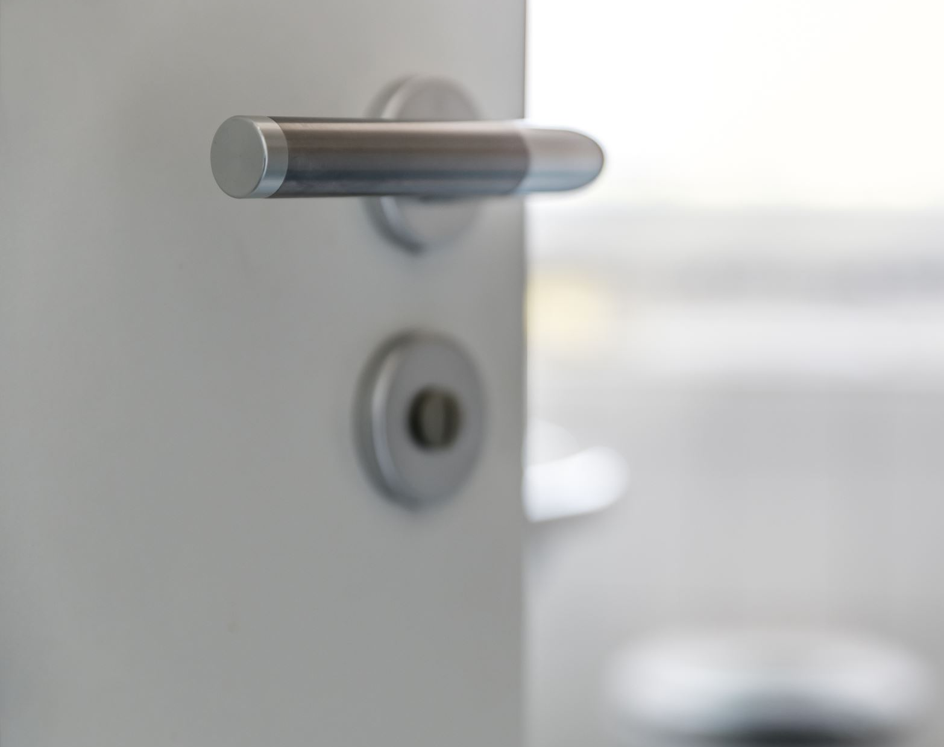
PROJECT-SMART DOOR LOCK

Slide 3

PROBLEM DISCRIPTION
MY PROBLEM IS THAT SOMETIMES WHEN WE GO OUT OF OUR HOMES OUR HOUSE KEYS GET STOLE OR DROP OF OUR BAGS OR POCKETS

Slide 4
WHO ARE THE USERS
THE USERS ARE THE PEOPLE GO TO WORK OR THE PEOPLE WHO STAY OUT OF THEIR HOUSES FOR A COUPLE OF DAYS

Slide 5
SOLUTION DISCRIPTION
THE SOLUTION OF MY PROBLEM IS THAT I HAVE MADE AN FINGERPRINT DOOR LOCKING SYSTEM SO THAT PEOPLE COULD USE THEIR FINGERPRINT TO UNLOCK THEIR HOME LOCKS IN PLACES OF KEYS

Slide 6
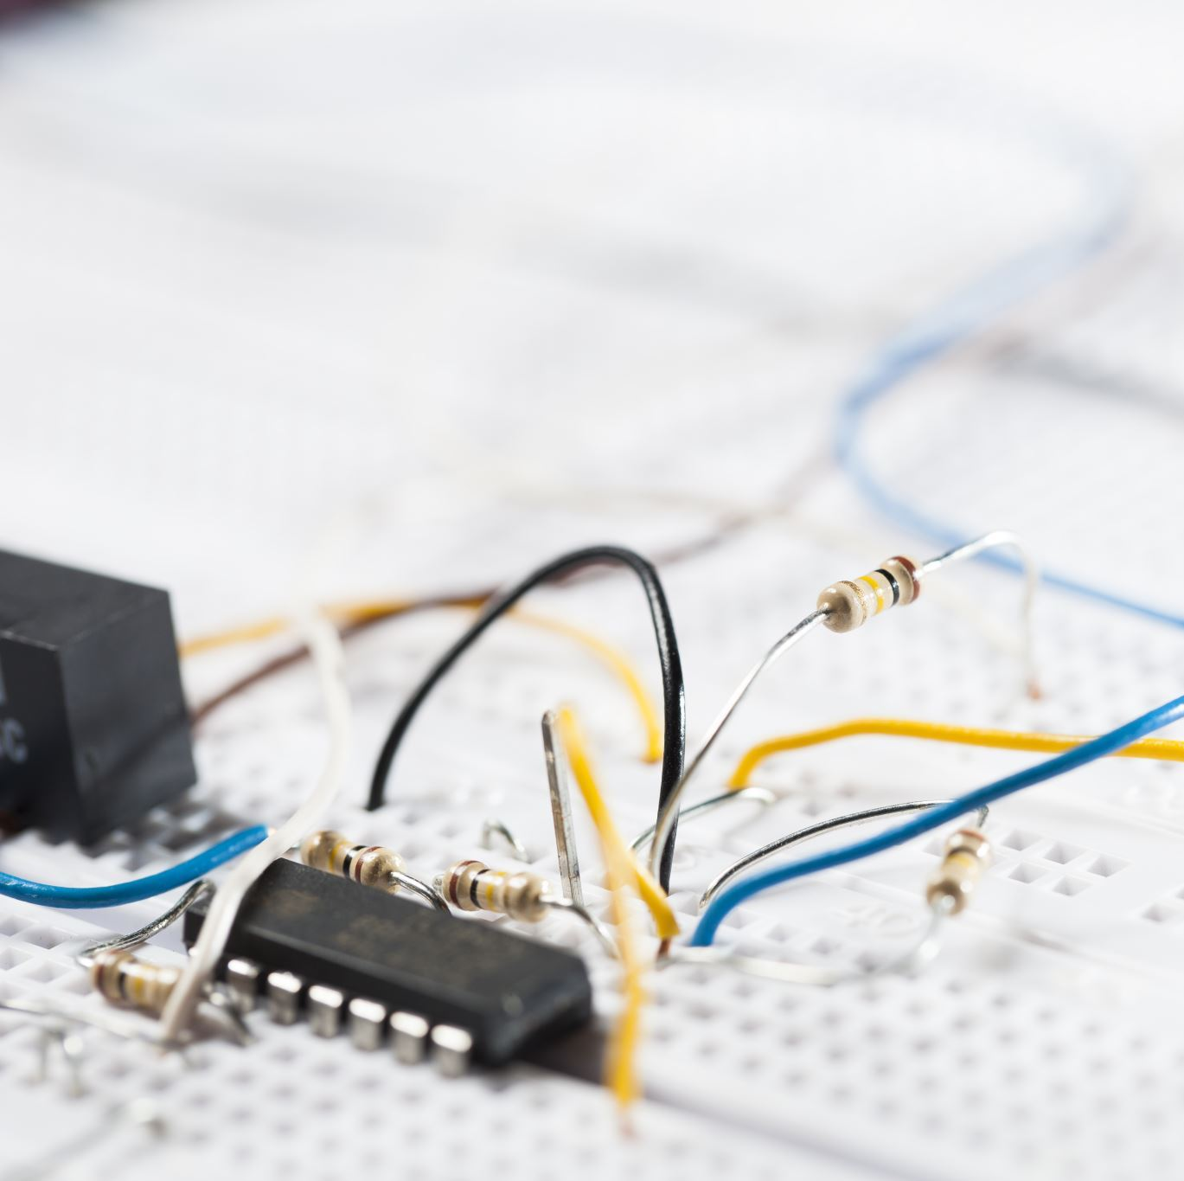
MATERIAL REQIURED TO MAKE THE CIRCUIT
ARDIUNO UNO R3
FINGERPRINT SENSOR
RELAY MODULE
Solenoid Lock
JUMPER WIRES

Slide 7

THANK YOU

